Slide 1
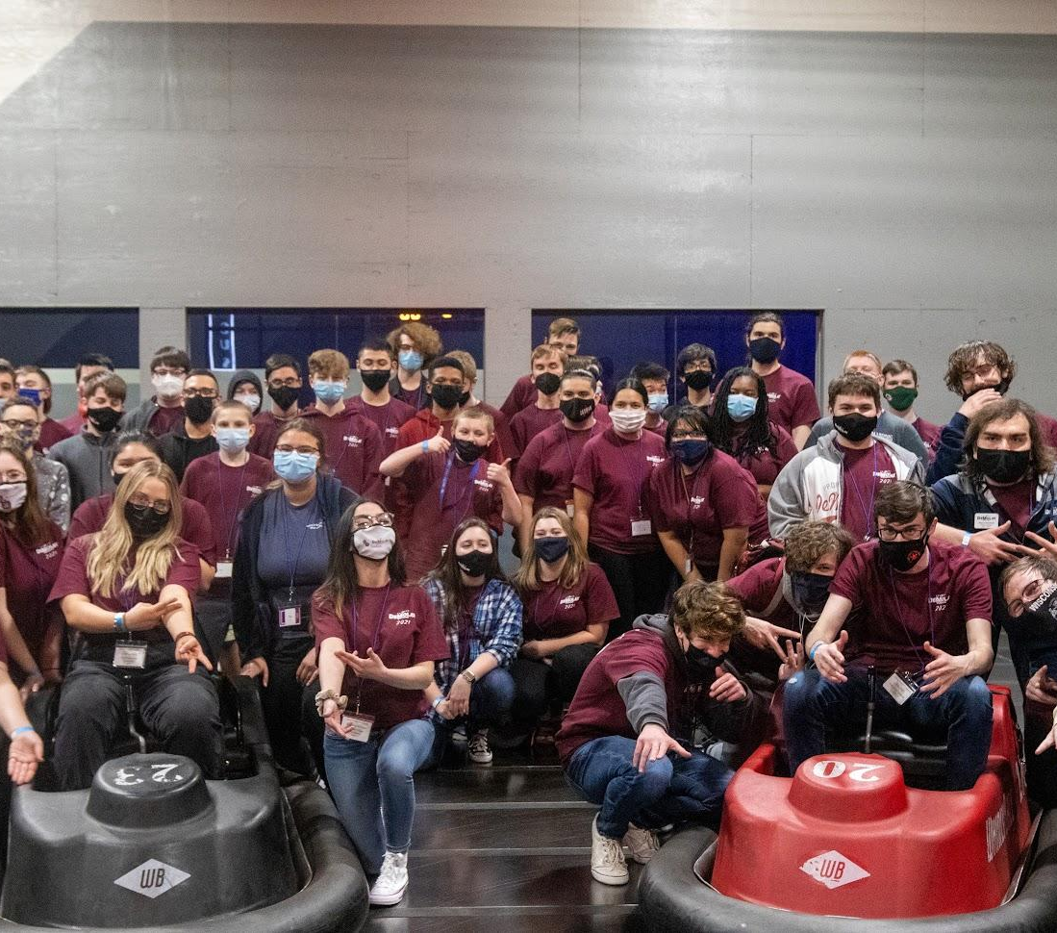
Wisconsin DeMolay
Prospective Member Event Playbook:
A Step-by-Step Guide

Slide 2
A Few Things Before We Start. . .
Prospective Member Events require a lot of work, so keep these in mind:
Work as a team! Successful events require the entire chapter to participate.
A lot of work is needed to pull off successful events.
Ask for help! Wisconsin DeMolay is here to assist you in ideas, funding, and more! Remember you are not alone.
Don’t give up! You will fail from time to time. Learn from those failures and implement what you learned into your next event.

Slide 3
Step 1: How Do We Get Names?
Getting names for prospective members can be hard, here are our suggestions for where to get names

Slide 4
1A: The Local Schools (Private/Public)
The local schools near your chapter are going to play a big role in how your chapter grows. Make sure you’re in contact with the schools each summer to get a list of names for the following year.
Reach out to the schools Principal and introduce them to DeMolay
We also suggest reaching out to school counselors to provide them with DeMolay materials to place in their office.
Request lists for 6th-8th graders for the following year.
Only reach out to School Boards or District Offices if told by the school’s Principal. Boards may have to vote before giving them.
See the folder that this slideshow is in for an example letter/email to send to school principals

Slide 5
1B: Family Members of Appendant Bodies
Chapters should always maintain a healthy relationship with the masonic bodies in their own building and around them, whether that be your Masonic Lodges, Eastern Star Chapters, or York Rite bodies make sure to be in constant communication with them and inviting them to your chapter events.
At least twice per year we recommend that chapters visit these lodges to give presentations on DeMolay, your chapter’s current term, and to ask them for the names of anyone in their families or their close friends who have young men of DeMolay age (Ages 12-14 are preferred).

Slide 6
1C: Friends and Family of Chapter Members and Advisors
Your Active Members are also going to be a big outlet when it comes to getting new members into the organization. Through their friends at school, sports groups, and more, you should be able to get a decent list of names from them.
ASK YOUR MEMBERS TO GET THEIR PHONES OUT AND LIST OFF PEOPLE THEY CAN CONTACT.

Slide 7
Step 2: What Events Do We Do?
What events are working? What events do your members want to do?

Slide 8
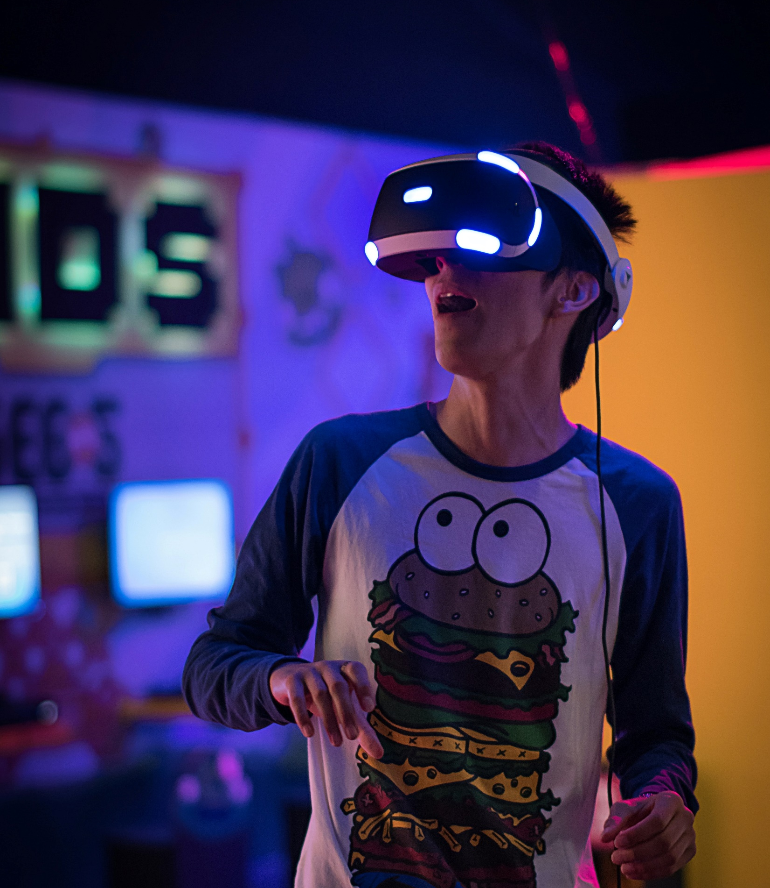
Brainstorm Event Ideas
When it comes to planning events for your chapter you must make sure that you are providing the youth with an event that is going to not only impress them but want them to keep coming back.
THINK BIG!
Do not just do an open house or an event at your lodge! No teen wants to attend that as a first experience of DeMolay.
Go somewhere that a 12-14 year old would find fun!
Examples include Laser Tag, Go Karts, Arcades, Mini-Golf, Movie Nights (In a theatre), Bowling.
Ask your members what they like to do for fun!
Always be thinking of a follow up Open House event
Should be done at least 5 months prior to when you want to hold your event!

Slide 9
The Initial Planning
4 months out
The initial planning stages include the following steps to finalize your event idea as well as securing a date and location for your event
Step 3: What is your event?
Set the program/itinerary for the event.
Step 4: Choose a venue
Keep in mind that the venue reflects on the organization as it is the first impression for prospective members and their parents.
Step 5: Choose a date
This is placed at least four months out to allow the chapter time to finish planning and promote the event as well as making sure the venue has your available date.
Step 6: Reserve the venue
Pay any deposits needed at the time and keep receipts for reimbursement from the state later.
Step 7: Finalize the Budget
Budget should include venue cost, estimated printing/mailing costs, decorations, food/drink, and any other necessities based on your event

Slide 10
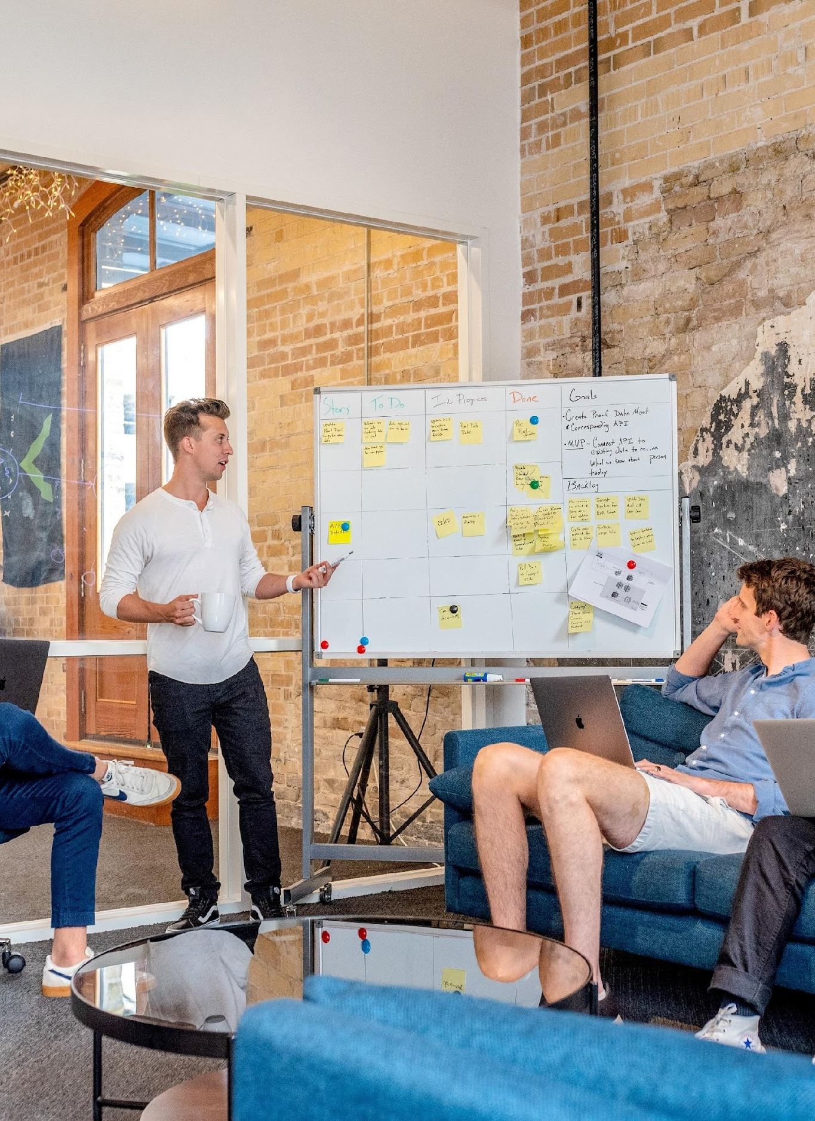
Step 8: Assigning Responsibilities
3 Months Out
Now that you have your initial event plans set, let’s put together some responsibilities for chapter members and advisors.
You need to divide up the following responsibilities:
Invitations and mailings
Advisor(s) will need to mail merge all lists, print labels, purchase envelopes and postage, and edit/print letters for parents/prospective members prior to Step 11.
Establish an RSVP Date 1-2 weeks prior to the event.
Choose one advisor to handle all RSVPs.
Obtaining Promotional Supplies
Promotional and marketing materials, applications, popup banners, etc.
Who will welcome people at the event?
1 DeMolay and 1 advisor that can hold a conversation and can be welcoming and approachable.

Slide 11
Assigning Responsibilities (Cont.)
4. Who will be manning registration/check-in
Whoever is doing this should be responsible for obtaining the prospective members and parents' email and phone number for further contact after the event.
5. Who will be giving a personal “thanks for coming” at the end of the event?
This is where you should be giving them an application for membership, marketing materials, and an invitation to your upcoming Open House event.

Slide 12
Step 9: Recruitment Reimbursement Program
3 Months Out
One crucial step for every prospective member event that you should keep in mind is that Wisconsin DeMolay offers reimbursement for these events through our Recruitment Reimbursement Program.
Submit the estimated budget and event itinerary to the Executive Officer prior to the event.
UMB will grant $750/per 6 month term for membership-based events
Receipts must be presented after the event (More in Step 21).

Slide 13
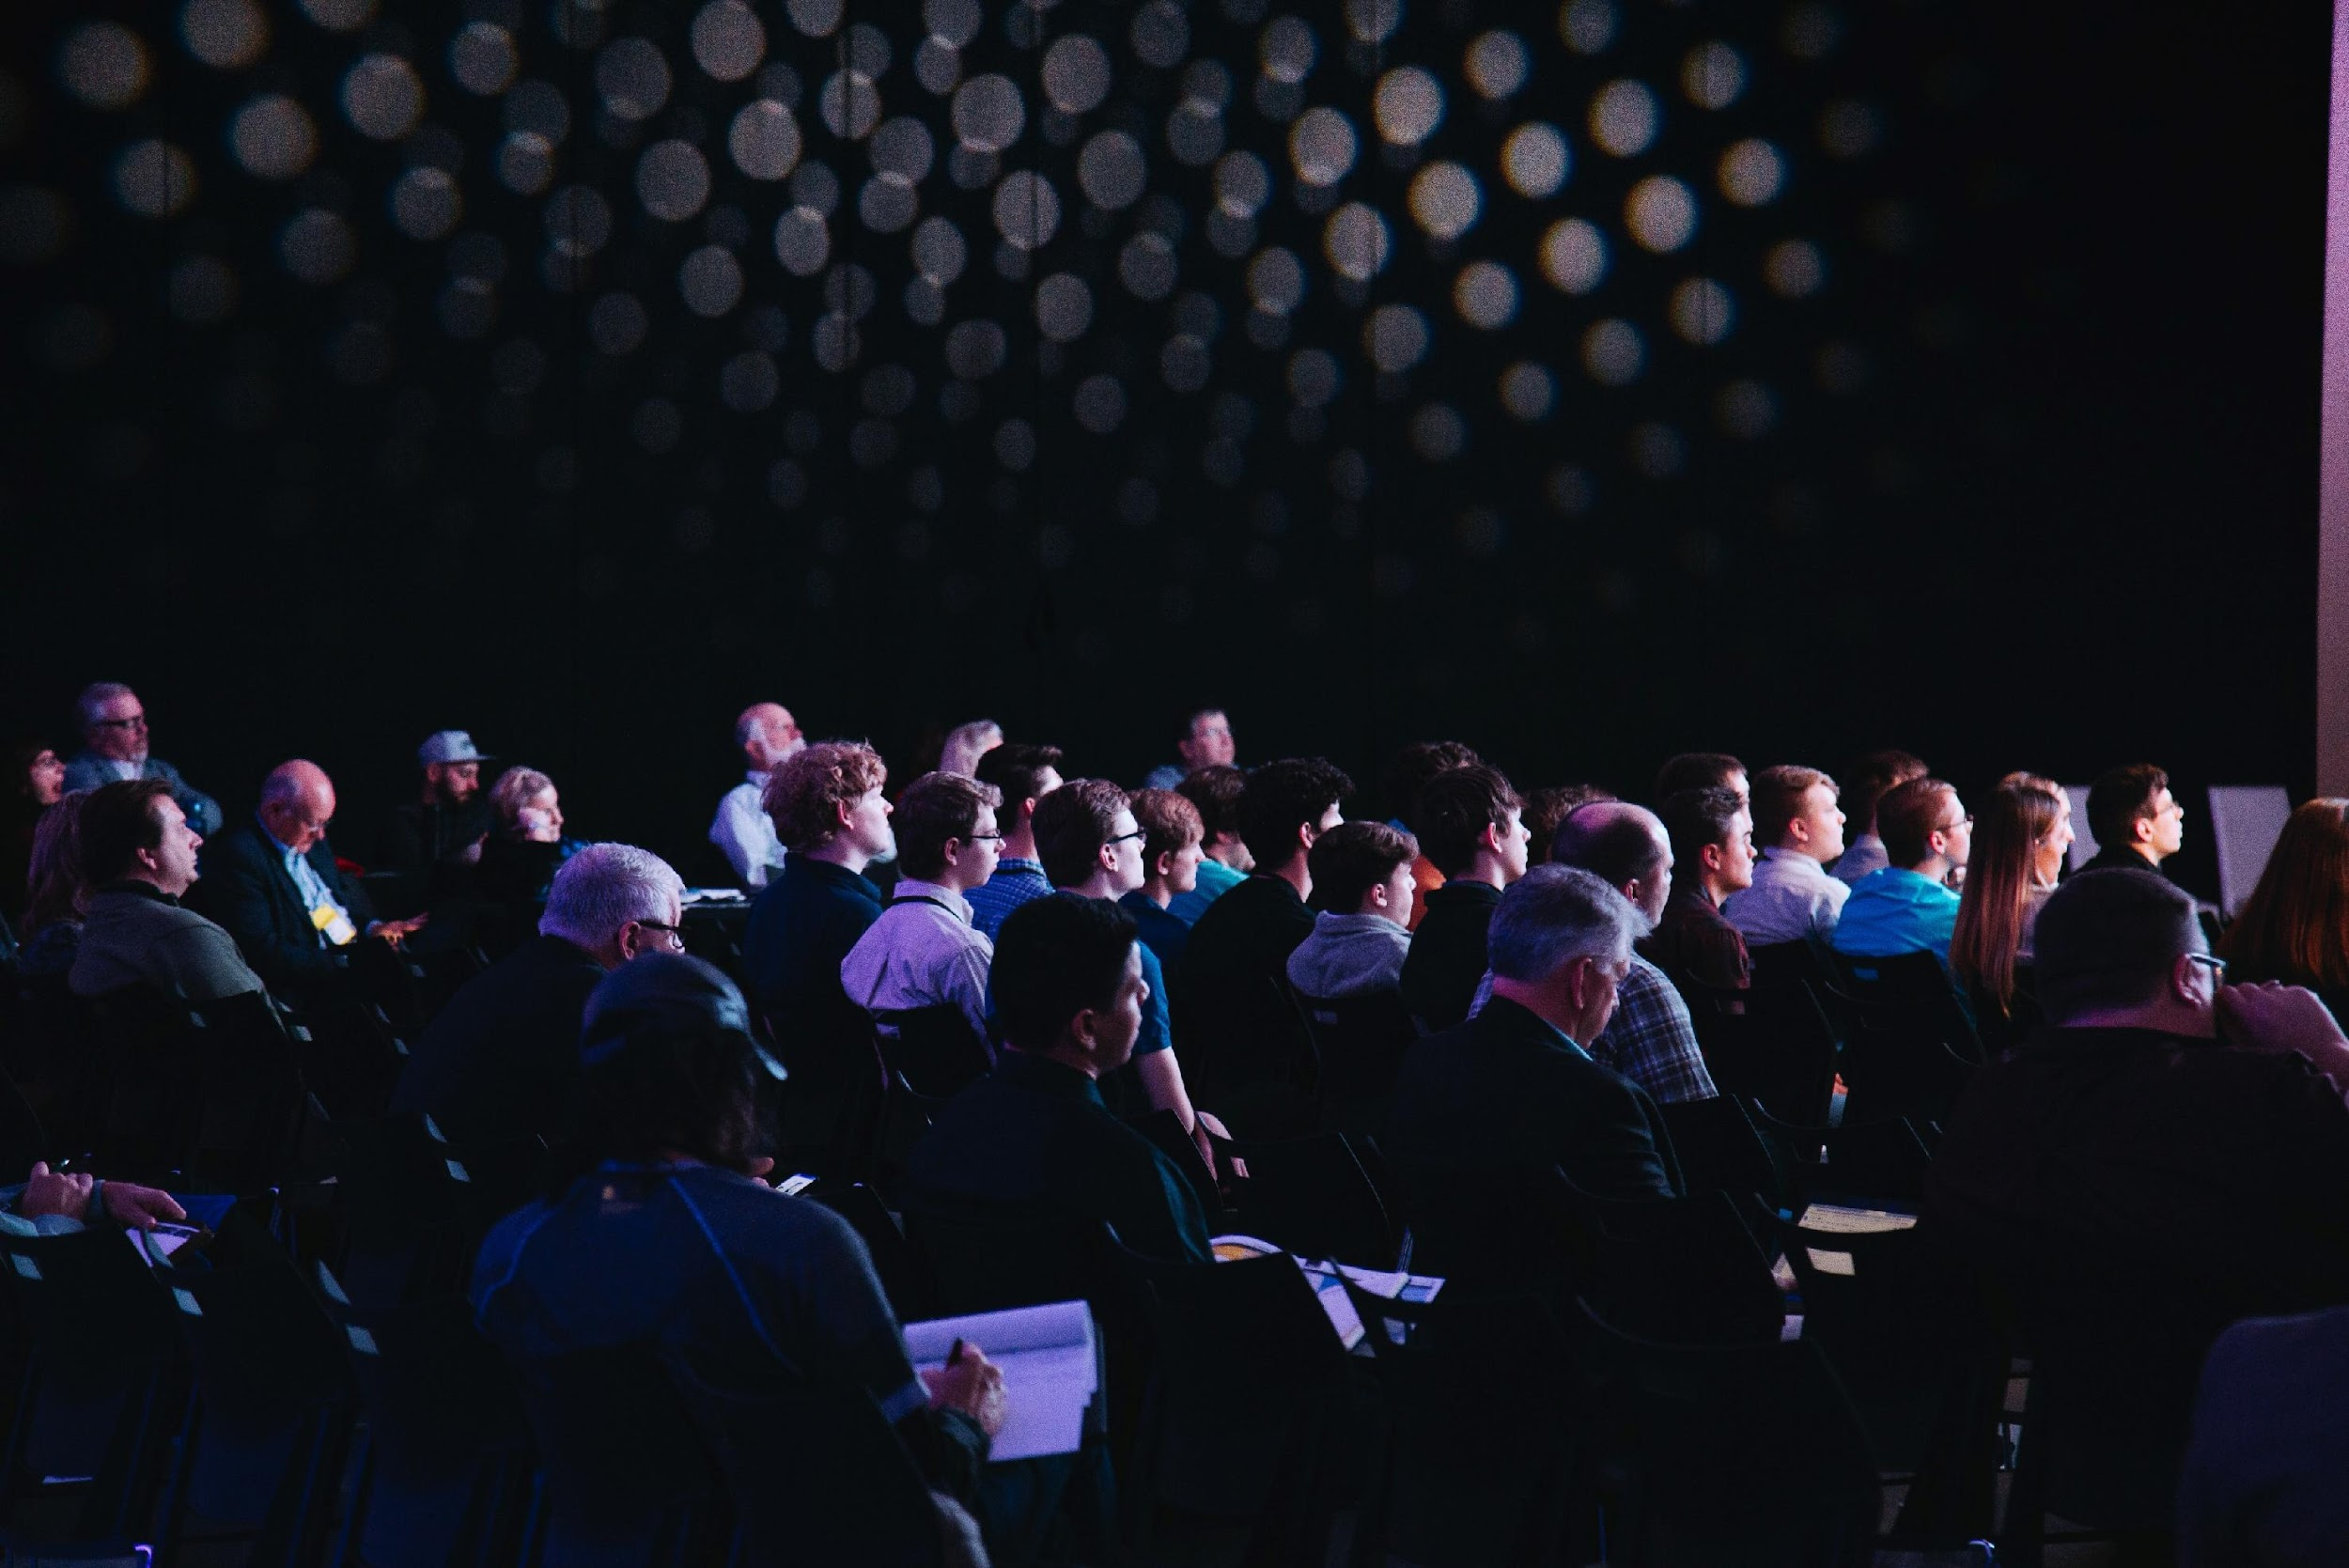
Step 10: Open House Prep
3 Months Out
After your membership event you will want to host an open house at least 2-4 weeks after to help keep people interested and engaged.
You will need to accomplish the following:
Choose which meeting night will be replaced with your open house.
DO NOT HAVE A MEETING DURING YOUR OPEN HOUSE
What is the program for the night?
Who will be speaking?
Which DeMolay will be welcoming everyone?
Which advisor will be giving the open house presentation?
What will the boys be doing for fun during the parent's section?
Will there be food/beverages? Who will purchase those?
Who will be responsible for Chapter Room setup and Lodge cleaning?
Visit widemolay.org/membership-corner to download the open house presentation.

Slide 14
Event Promotion
2 Months Out
Now is the time to start promoting your event to those on the prospective member lists mentioned earlier as well as internally with our chapters in Wisconsin DeMolay!
Step 11: Package/Send out Mailings
Schedule a time where those responsible for invitations and mailings can meet to properly fold and package mailings
Mail out all invitations when they are completed
Step 12: Internal Promotions
Invite the following entities to encourage a larger DeMolay presence
Chapters, State Officers, Priory, Court of Chevaliers
Strongly encourage Active DeMolay to wear DeMolay attire.
Submit event to the Operations Coordinator at websubmissions@widemolay.org to insert into the Badger and on the website. Also request Social Media posts and promotional materials if needed.

Slide 15
Step 13:
Take a breath
you earned it.
Most of your work at this point is done! There are only a few more things to do before your event so take a much-needed break.

Slide 16
The Last Month
Your event is 30 days out, time to complete the final small tasks leading up to your event
Step 14: Final Internal Promotion
Reminder email to all the entities from Step 12
Step 15: RSVP Follow Ups
Find out how many people are RSVP’d to gauge need for supplies and food/beverages.
Share final numbers with the venue if needed
Step 16: Establish a Transportation Plan
How will your chapter members get to and from the event?
Remind members that they should arrive 30-45 minutes prior to the event.

Slide 17
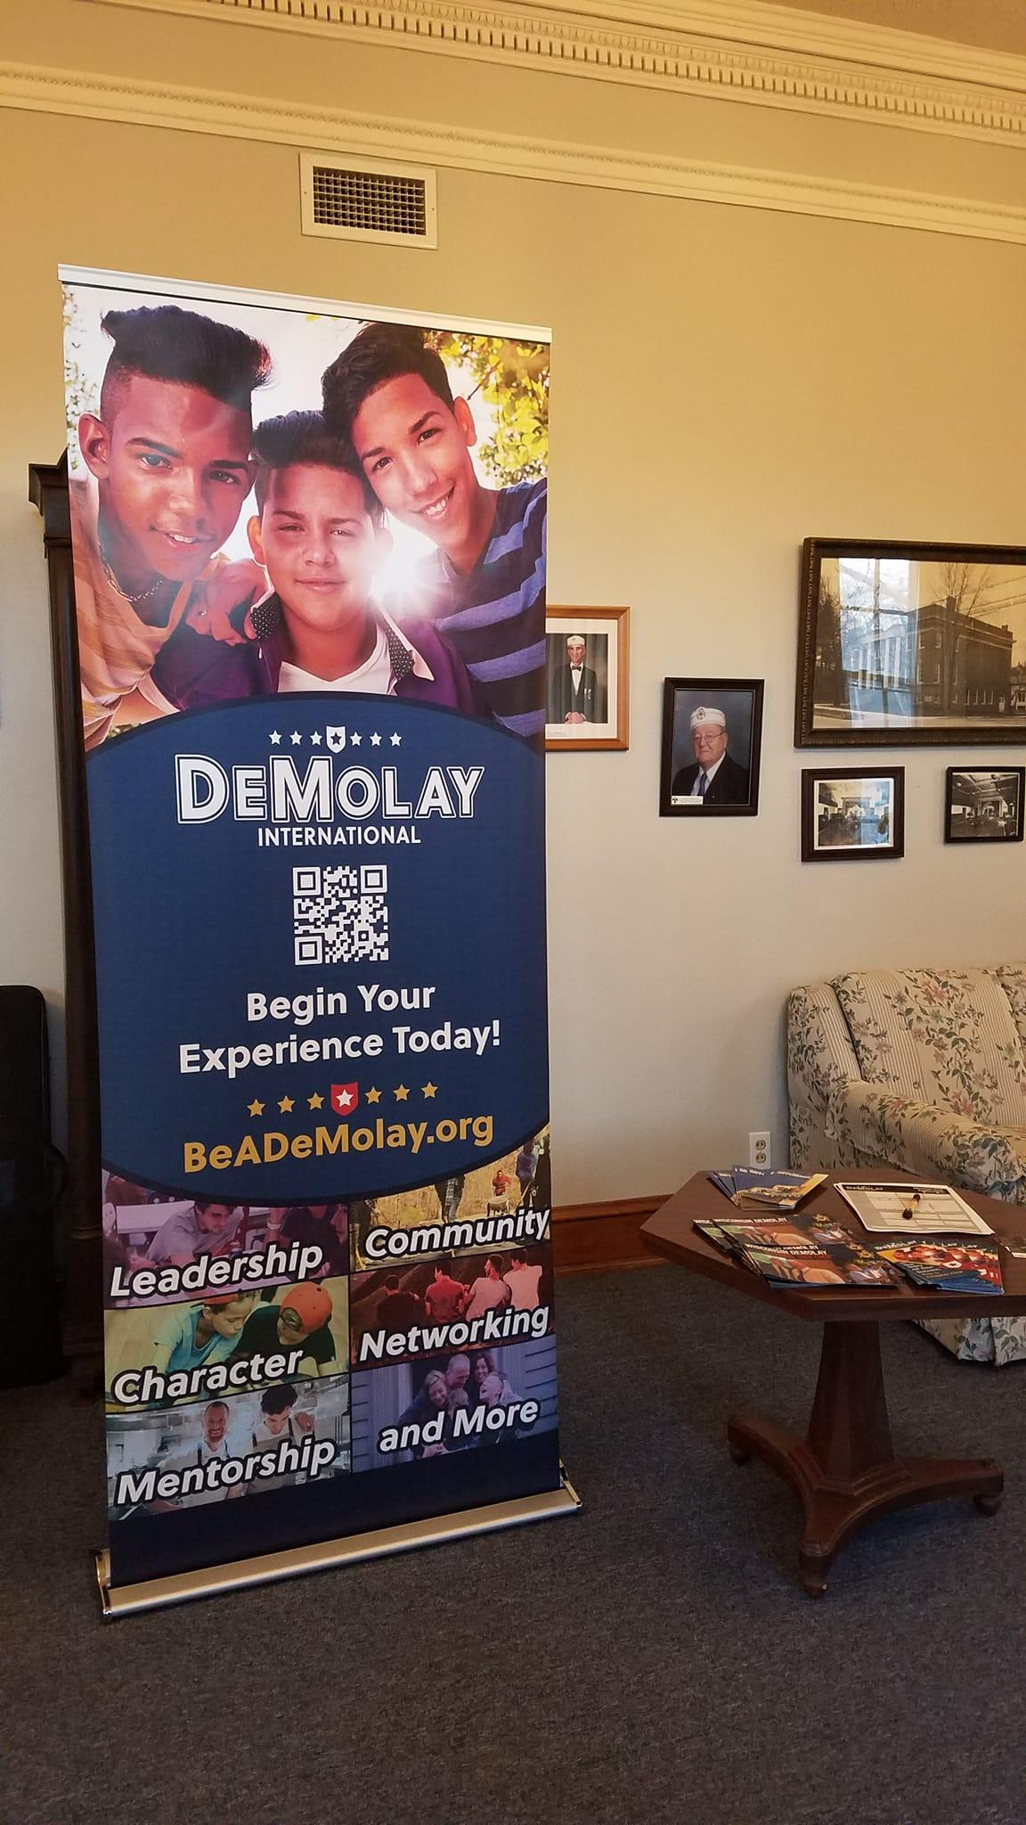
Step 17: Final Preparations
The Week Of
Your event is less than 7 days away! You should be excited to put off an amazing event for your chapter members and prospective members and parents.
Here are your tasks to keep in mind for the week of your event:
Purchase supplies based on RSVP numbers
Final reminder for chapter members to arrive early wearing DeMolay attire
Pick up any promotional materials requested from the Operations Coordinator.

Slide 18
Step 18: The Day Of
The day of your event is here! Make it an amazing one.

Slide 19
Tips for a Successful Day!
Like we said, it’s time to make an amazing day of your event, here are some of our tips to help you.
Arrive Early (30-45 minutes prior).
Meet with the venue manager to go over any last-minute details.
Complete any setup (if required).
Review roles and responsibilities.
15 minutes out, everyone take their places.
Welcome each member/parent like they are already members
No DeMolay should be in the corner by themselves
Every prospective member should leave with an invite to your open house, promotional material, and an application
Make sure to smile, be excited, and have fun at all times throughout the event. Keep in mind, no one wants to join an organization that doesn’t look like fun.

Slide 20
Step 19: Follow Ups
1 Week After Event
THANK YOU
FOR COMING!
One of the biggest things we need to remember after our membership events is to follow up with the families who attended and making sure they are still aware of our next event.
Send a follow up email to the prospective members/parents thanking them for attending and sending them information on your open house again. See the example in the folder for this slideshow.
Send an email to the chapters, priory, and state officers inviting them to your open house.

Slide 21
The Open House
2-4 Weeks After
Step 20: Preparations
Purchase any supplies or decorations needed for the Open House
Step 21: Open House Day
Arrive Early to setup the chapter room and fun event
Make sure everything is clean
Review roles and responsibilities
15 minutes prior everyone should be in place.
All your visitors should be greeted either outside or at the front door.
HAVE FUN!

Slide 22
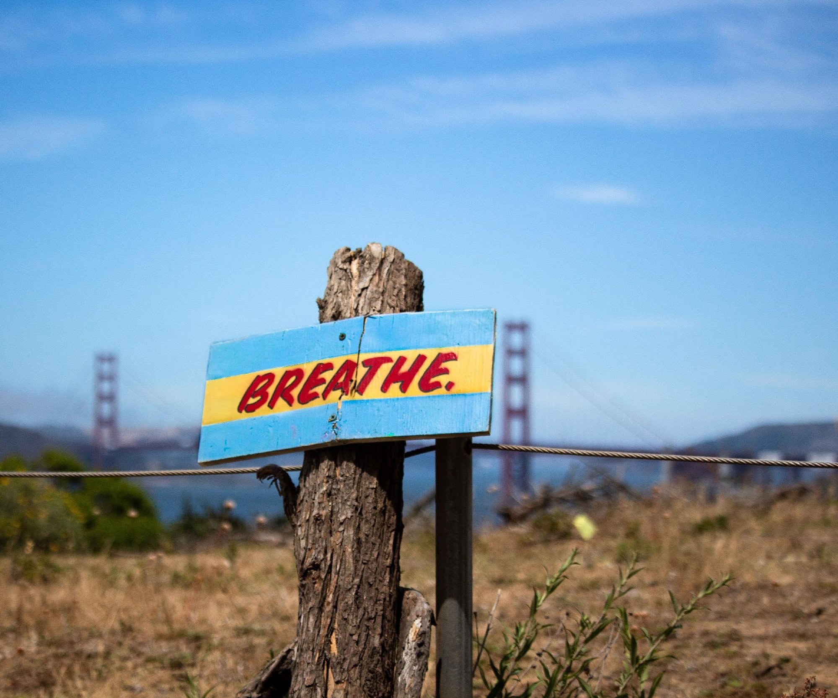
Your Final Steps. . .
Step 22: Finalize Reimbursements
Send in all your receipts to the Executive Officer for approval for reimbursement through the Recruitment Reimbursement Program.
Step 23: Continued Correspondence
Continue to follow up with attendees and invite them to your upcoming chapter meetings and fun events.
Encourage them to submit their applications.

